Slide 1
SS ZG653 (RL 15): Software Architecture Design Patterns- Structure
Instructor: Prof. Santonu Sarkar
March 18, 2015

Slide 2
Structural Patterns
Design Patterns

Slide 3
What is it?
A set of design patterns
Provides easy and generalized techniques to realize relationships between entities
We shall study
Decorator pattern
Adapter pattern
Composite pattern
Proxy pattern

Slide 4
Decorator Pattern
15.1

Slide 5
Decorator Pattern
A component object need to be enhanced (a window to have a scrollbar) or additional responsibilities to be added
The decorated object can be used in the same way as the undecorated object
The original component class does not want to take on the responsibility of the decoration
There may be many possible decorations

Slide 6
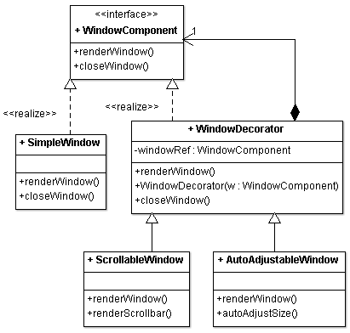
Decorator Pattern Class Diagram
Define an interface that is an abstraction for the component
Concrete component classes realize this interface type
Decorator classes also realize this interface type
Decorator object manages the component object that it decorates
When implementing a method from the component interface type, the decorator class applies the method to the decorated component
Combines the result with the effect of the decoration

Slide 7
Using a Decorator
public class MyGUIApp {
public static void main(String[] args) {
// create a new window
Window w = new ConcreteWindow();
w.renderWindow();
// sometime later, you find that too much text!!
// So you need scrolling functionality through decoration
w = new ScrollableWindow(w);
// now window object has additional behavior w.renderWindow();
}
}
GUI Main function use the decorator pattern by
Creating a Decorated object (ScrollableWindow)
Invoking the main method w.renderWindow()defined in the interface

Slide 8
Usage in JDK
FileIO
Reader is the interface
A BufferedReader is a Decorator
Reader r = new BufferedReader(new FileReader("readme.txt"));
r.read();

Slide 9
Consequences
Decoration is more convenient for adding functionalities to objects instead of entire classes at runtime
With decoration it is also possible to remove the added functionalities dynamically
Decoration adds functionality to objects at runtime which would make debugging system functionality harder

Slide 10
Adapter Pattern
15.2

Slide 11
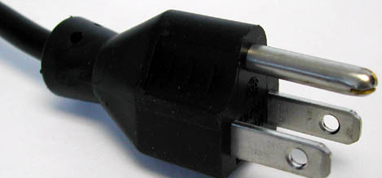
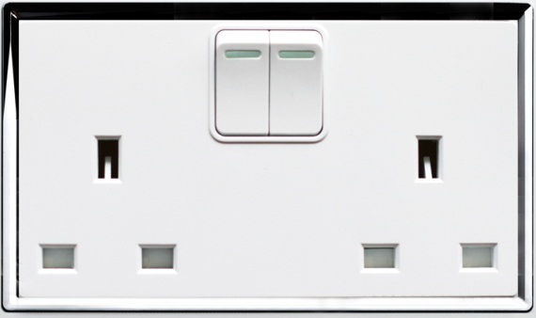
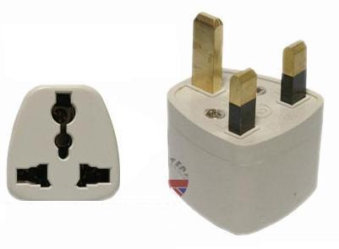
Introducing Adapter Pattern
Req. is transferred
Client
Adapter
Actual Service Provider (Adaptee)
Makes a req.
Like any adapter in the real world, an Adapter it is a bridge between two objects
One class expecting some type of object and you have an object offering the same features, but exposing a different interface
Certainly both of them should be used instead of re-implementing
Changing existing classes is not an option
Therefore, why not create an adapter...

Slide 12
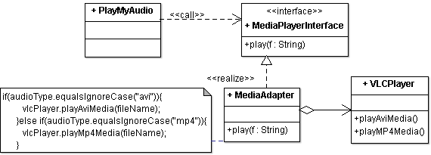
Adapter pattern class diagram
Define an adapter class that implements the Target interface
Adapter lets classes work together, that could not otherwise because of incompatible interfaces
The adapter class holds a reference to the Adaptee. It translates target methods to Adaptee methods.
Adaptee is wrapped into an adapter class object
Composition plays an important role
Target
Adaptee

Slide 13
Usage of Adapter Pattern
public class PlayMyAudio {
public static void main(String[] args) {
MediaPlayerInterface player = new MediaAdapter(); player.play("beyond the horizon.avi");
player.play("alone.mp4");
}
}
3rd parties libraries and frameworks - most of the applications using third party libraries use adapters as a middle layer between the application and the 3rd party library to decouple the application from the library
Suppose that you change this 3rd party library. Then only an adapter for the new library is required without having to change the application code.

Slide 14
How much should the Adapter work?
it should do only that much which is necessary in order to adapt
If the Target and Adaptee are similar then the adapter has just to delegate the requests from the Target to the Adaptee
If Target and Adaptee are not similar, then
the adapter might have to convert the data structures between those
implement the operations required by the Target but not implemented by the Adaptee

Slide 15
Composite Pattern
15.3

Slide 16
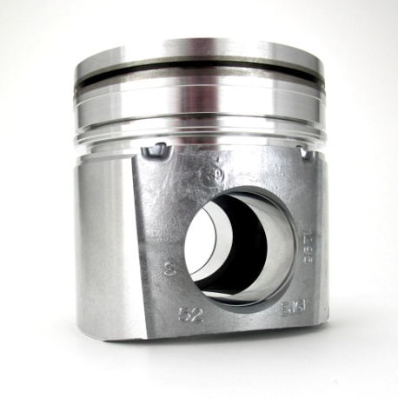
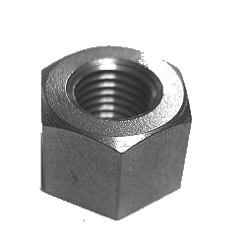
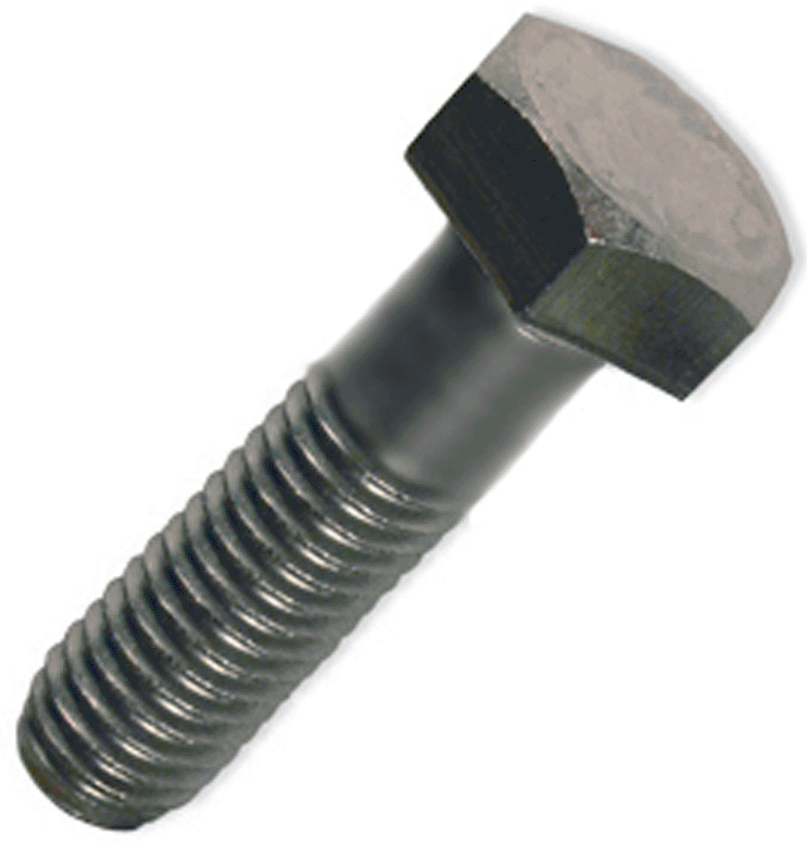
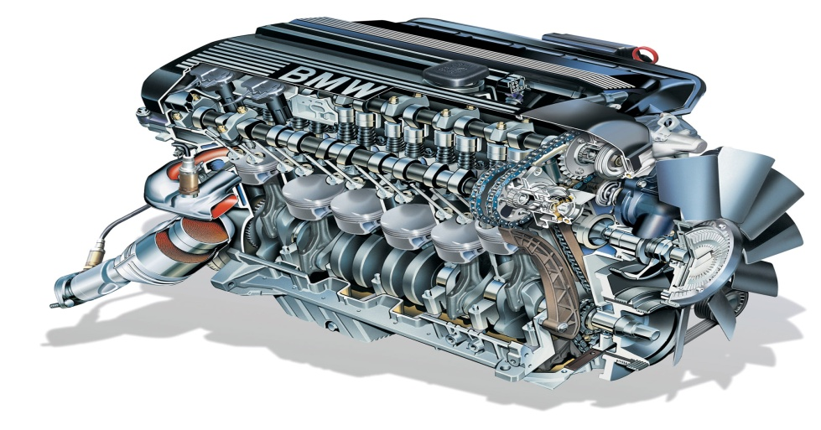
Primitive vs Composite Objects
Primitive Objects are atomic objects which can not be put into any other object
Composite Objects are collection objects which can contain other objects (primitive or composite)
Moreover, Composite lets clients treat individual objects and compositions of objects uniformly

Slide 17
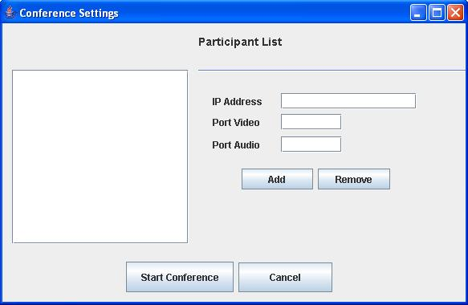
A typical GUI Application
Button, Radio Button, Check Box, Text Fields,
Primitive Objects
Composite Objects
JFrame, JPanel
Panel 0
Panel 1
Panel 2
Panel 3

Slide 18
Composite Pattern Requirement
There are some operations that needs to be applied on both primitive as well as composite objects
Interface for operation (whether for primitive type or composite type) is same
Any operation for primitive type object is atomic in nature but the same operation for a composite type object is recursive in nature

Slide 19
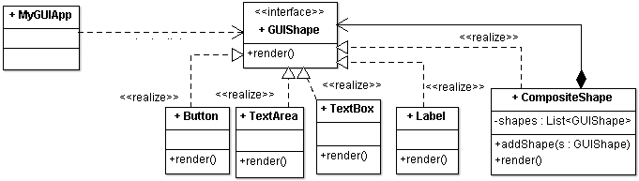
Composite Pattern Class Diagram
STEP 1: Create an interface for Common Operations
STEP 2: Both Primitive and Composite Objects Realize the same interface
STEP 3: Make Composite Objects as a collection of primitive objects

Slide 20
Using Composite Pattern
public class MyGUIApp {
public static void main(String[] args) {
// create a rectangle shape
GUIShape addButton= new Button(); GUIShape remButton= new Button();
GUIShape startButton= new Button();
GUIShape cancelButton= new Button();
GUIShape ipL= new Label(); GUIShape ipT= new TextBox();
CompositeShape complexComp= new CompositeShape();
complexComp.addShape(addButton); complexComp.addShape(remButton);
complexComp.addShape(ipL); complexComp.addShape(ipT);
CompositeShape veryComplexShape= new CompositeShape();
veryComplexShape.addShape(complexComp);
veryComplexShape.addShape(startButton);
veryComplexShape.addShape(cancelButton);
veryComplexShape.render();
}
}

Slide 21
Consequences
The composite pattern defines class hierarchies consisting of primitive objects and composite objects. Primitive objects can be composed into more complex objects, which in turn can be composed
complexComp
veryComplexShape.addShape(complexComp);
Clients treat primitive and composite objects uniformly through a component interface (GUIShape) which makes client code simple
Adding new components can be easy and client code does not need to be changed since client deals with the new components through the component interface (GUIShape)

Slide 22
Proxy Pattern
15.4

Slide 23
Motivation and intent
We need the ability to control the access to an object.
For example if we need to use only a few methods of some costly objects we'll initialize those objects when we need them entirely.
Till that situation arises, we can use some light objects exposing the same interface as the heavy objects.
These light objects are proxy objects
They will instantiate those heavy objects when they are really need
This ability to control the access to an object
When a costly object needs to be instantiated and initialized
Different access rights to an object, as well as
Providing a sophisticated means of accessing and referencing objects running in other processes, on other machines.

Slide 24
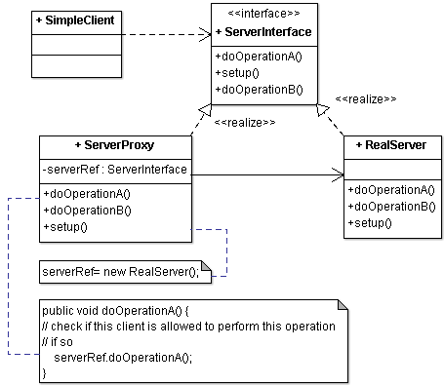
Class Diagram
A client obtains a reference to a Proxy, the client then handles the proxy in the same way it handles RealSubject and thus invoking the method doOpeationA().
This interface is implemented by both Real subject and proxy
Maintains a reference that allows the Proxy to access the RealSubject.
Implements the same interface implemented by the Real Subject so that the Proxy can be substituted for the RealSubject.
Controls access to the RealSubject and may be responsible for its creation and deletion
the Real subject that the proxy represents

Slide 25
Client calling Proxy
public class SimpleClient{
public static void main(String[] args){
ServerInterface server = new ServerProxy();
server.setup();
server.doOperationA();
server.doOperationB();
try {
executor.runCommand("ls -ltr");
executor.runCommand(" rm -rf abc.pdf");
} catch (Exception e) {
System.out.println("Exception Message::"+e.getMessage());
}
}
}

Slide 26
Examples
Remote Proxy--Java RMI
An object on one machine (executing in one JVM) called a client can invoke methods on a remote object in another machine (another JVM)
The proxy (also called a stub) resides on the client machine and the client invokes the proxy in as if it is invoking the object itself
The proxy itself will handle communication to the remote object, invoke the method on that remote object, and would return the result if any to the client
Proxy contains machine address, process id, object id

Slide 27
Examples
Virtual Proxy: Lazy loading when the data size is huge
In place of a complex or heavy object, use a skeleton representation.
When an underlying image is huge in size, just represent it using a virtual proxy object and on demand load the real object
Protection Proxy: Restricts access
Checks access rights before invoking the actual operation
Accessing public e-mail, social networking, data storage etc. in a corporate setup

Slide 28
Examples
Firewall proxy
Proxy is a process on a firewall machine
Clients requests to outside world from within the firewall, is intercepted by this process
Depending on the security policy, it allows or stops the request
Incoming requests are also intercepted by proxy
Checks for compliance before passing to the server
Both inside and outside entities are oblivious to proxy until their requests are denied!!

Slide 29
Thank You

